Slide 1
SmartCredit
®
Product Features
Product Features
August 2022

Slide 2
Contents
3 -
Asset Guidelines & Confidentiality
9 -
Taking Action on Negative Accounts
4 -
How to Save & Use Images
10 -
Money Manager
5 -
SmartCredit® Overview
11 -
Alerts
Products & Features
12 -
$1MM Fraud Insurance
6 -
ScoreBoost™
13 -
PrivacyMaster®
7 -
ScoreTracker
14 -
3-Bureau Report & Scores
8 -
ScoreBuilder®
15 -
Smart Credit Report®
2
©2022 ConsumerDirect, Inc.® Proprietary and Confidential. All Rights Reserved.

Slide 3
Asset Guidelines & Confidentiality
Please Keep the Following Guidelines in Mind
Logos and designs cannot be stretched or distorted
Logo and design colors cannot be changed
Logos and designs are to be used exclusively in connection with our partnership and to promote SmartCredit®
3
©2022 ConsumerDirect, Inc.® Proprietary and Confidential. All Rights Reserved.

Slide 5
SmartCredit®
Build, Protect, and Maintain Your Future Credit Score
Our useful features help you take ownership of your
credit, money, privacy, and identity.
ScoreBoost™
Credit Monitoring
ScoreTracker
$1MM Family Fraud Insurance
ScoreBuilder®
3-Bureau Credit Report & Scores
Action Buttons
Smart Credit Report®
Money Manager
5
©2022 ConsumerDirect, Inc.® Proprietary and Confidential. All Rights Reserved.

Slide 6
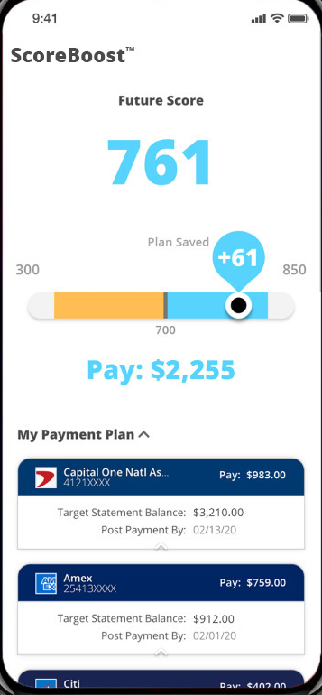
ScoreBoost™
Reach Your Target Score to Get Better Loans
How it Works:
See how payments can increase your score
Know when to apply for credit
Know the right time to repay
Balance spending between accounts
6
©2022 ConsumerDirect, Inc.® Proprietary and Confidential. All Rights Reserved.

Slide 7
ScoreTracker
Easily Track & Understand All Your Credit Scores
Credit Score
Summarizes your overall credit status
Auto Score
Shows creditworthiness for vehicle loans
Insurance Score
Displays creditworthiness for insurance
Hiring Risk Index
Shows creditworthiness for employment based on authorized background checks
7
©2022 ConsumerDirect, Inc.® Proprietary and Confidential. All Rights Reserved.

Slide 8
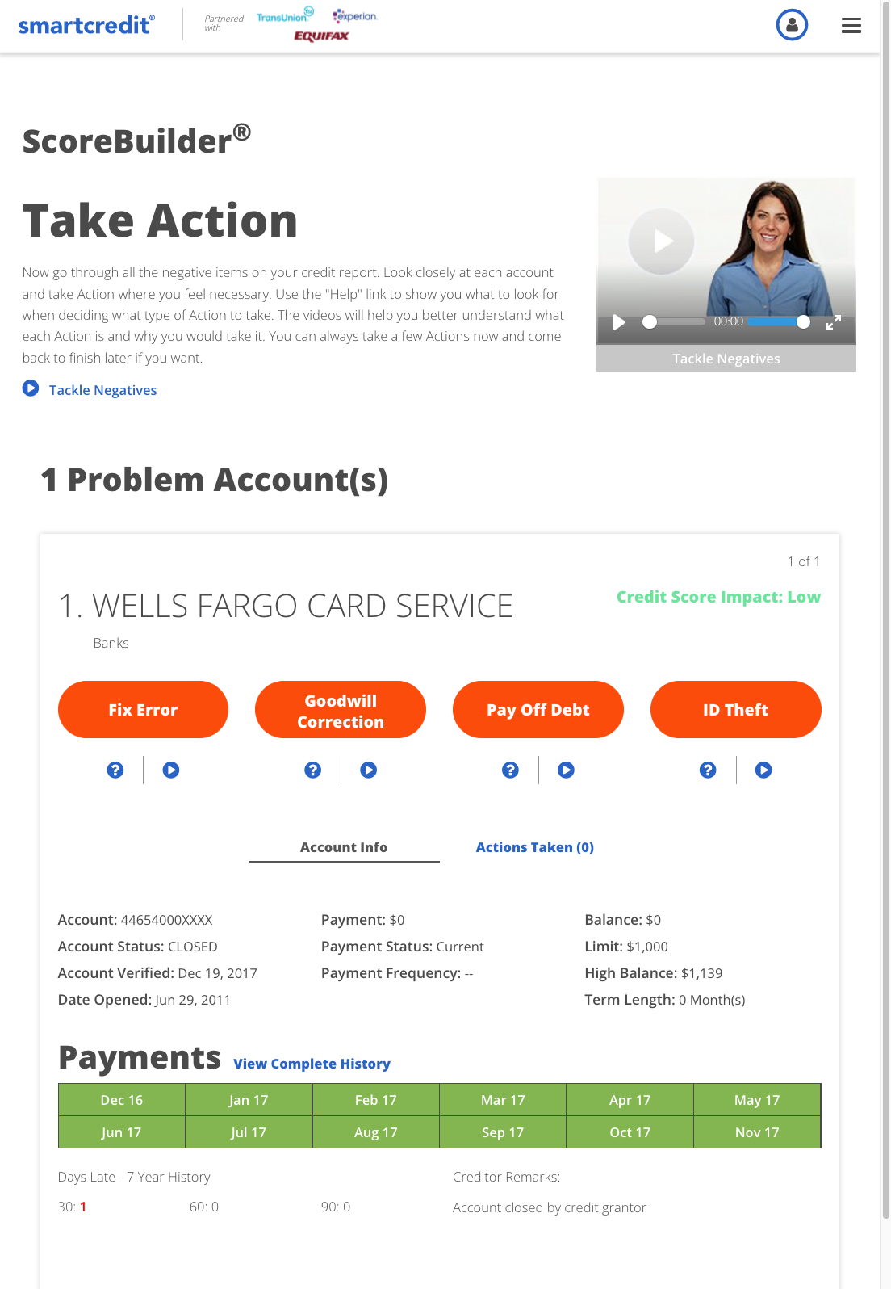
ScoreBuilder®
120 Days to Better Credit
See what’s helping and hurting your score
Get a personalized plan to improve your credit health
Take action to address negative accounts*
Resolve credit reporting problems
* This feature unlocks if you have negative credit data
8
©2022 ConsumerDirect, Inc.® Proprietary and Confidential. All Rights Reserved.

Slide 9
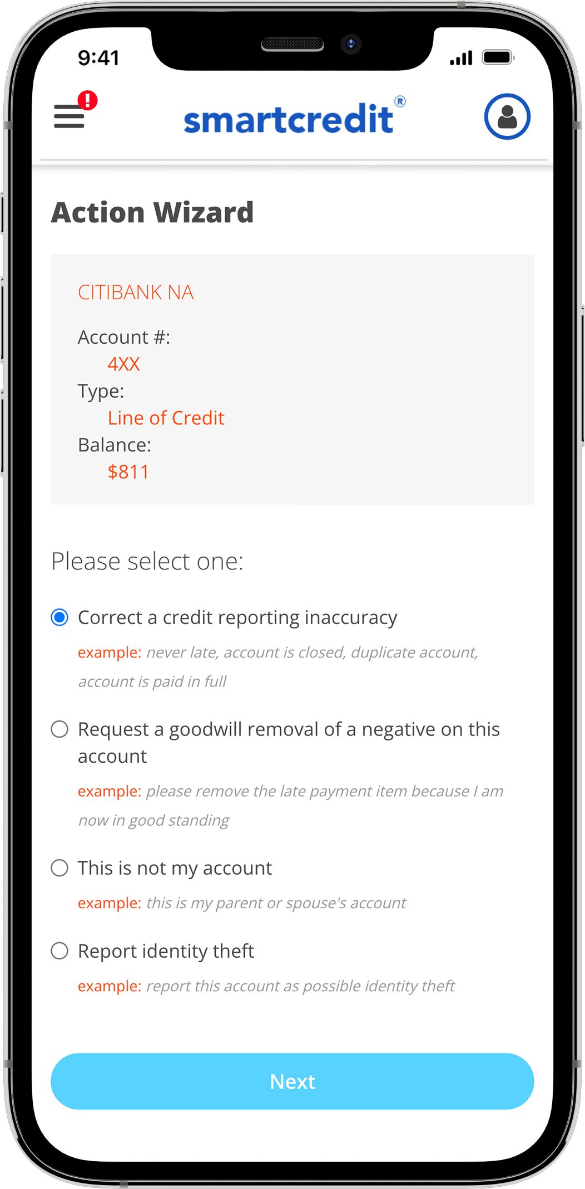
Take Action on Negative Accounts
Our Action buttons give you the ability to quickly
communicate with the institutions on your credit report.
Request goodwill corrections
Address credit report errors
Report fraud
Offer to settle a debt
9
©2022 ConsumerDirect, Inc.® Proprietary and Confidential. All Rights Reserved.

Slide 10
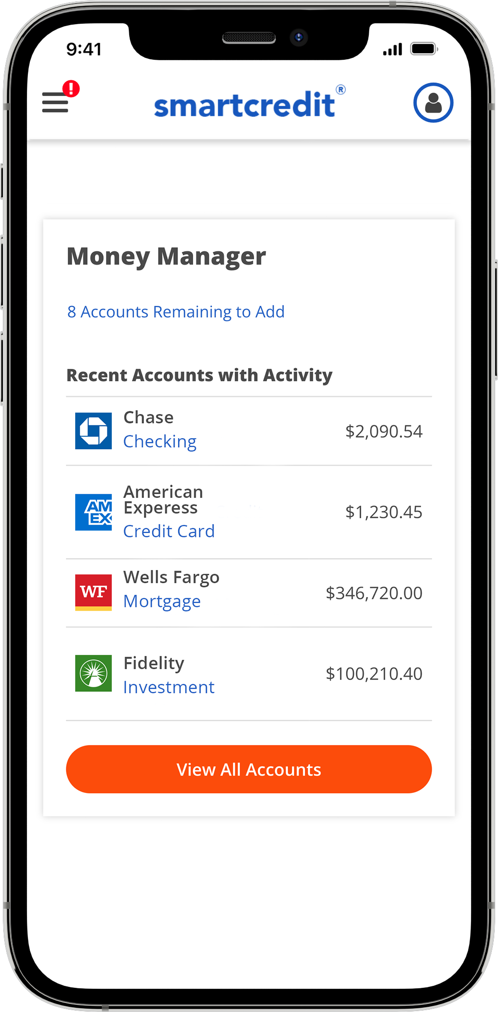
Money Manager
Your Money in One Place
Easily link bank, investment, loan, and credit card accounts
Get instant statements
See transactions, payments due, spending trends, and credit utilization
Ask questions and resolve problems directly with creditors
Get alerted of transactions over a specific dollar amount that you set
Flag unauthorized transactions with our patent-protected Action buttons
10
©2022 ConsumerDirect, Inc.® Proprietary and Confidential. All Rights Reserved.

Slide 11
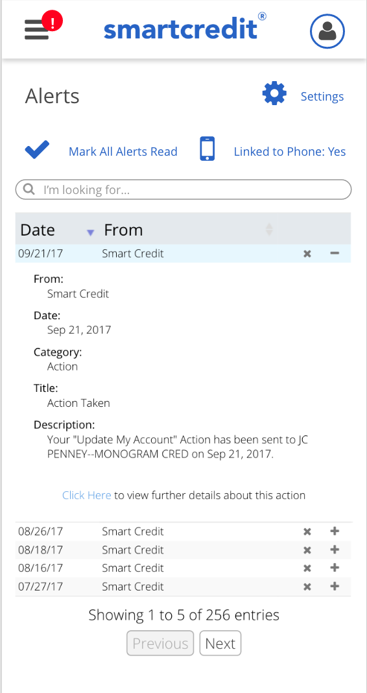
Alerts
Link Alerts to your phone to receive notifications for
the following:
New accounts and inquiries
Monthly credit updates
Change in account status
Money Manager transactions
Suspicious activity
Payments due
Score improvement
11
©2022 ConsumerDirect, Inc.® Proprietary and Confidential. All Rights Reserved.

Slide 12
$1 MM Family Fraud Insurance
Protection for the Entire Household
What's Covered:
Zero Deductible, $1 Million Coverage
Bank, savings, brokerage, lines of credit, and credit cards
Out-of-pocket expenses for ID recovery
Credit reports
Unsuspected pre-existing identity fraud
Replacement costs of stolen driver’s license and passport
12
©2022 ConsumerDirect, Inc.® Proprietary and Confidential. All Rights Reserved.

Slide 13
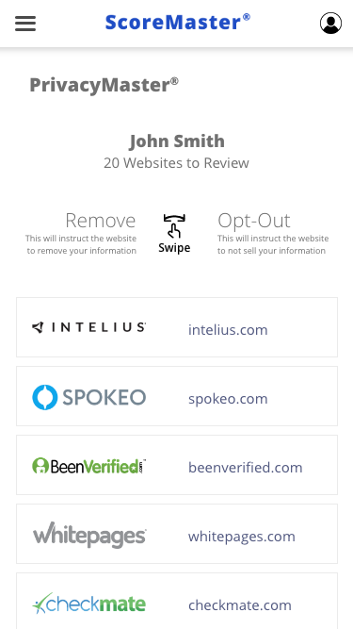
PrivacyMaster®
Take Back Control of Your Online Privacy
Get notified when your personal information is found on data broker websites
Request the removal of your data
Maintain your privacy with active and continual
web scanning
13
©2022 ConsumerDirect, Inc.® Proprietary and Confidential. All Rights Reserved.

Slide 14
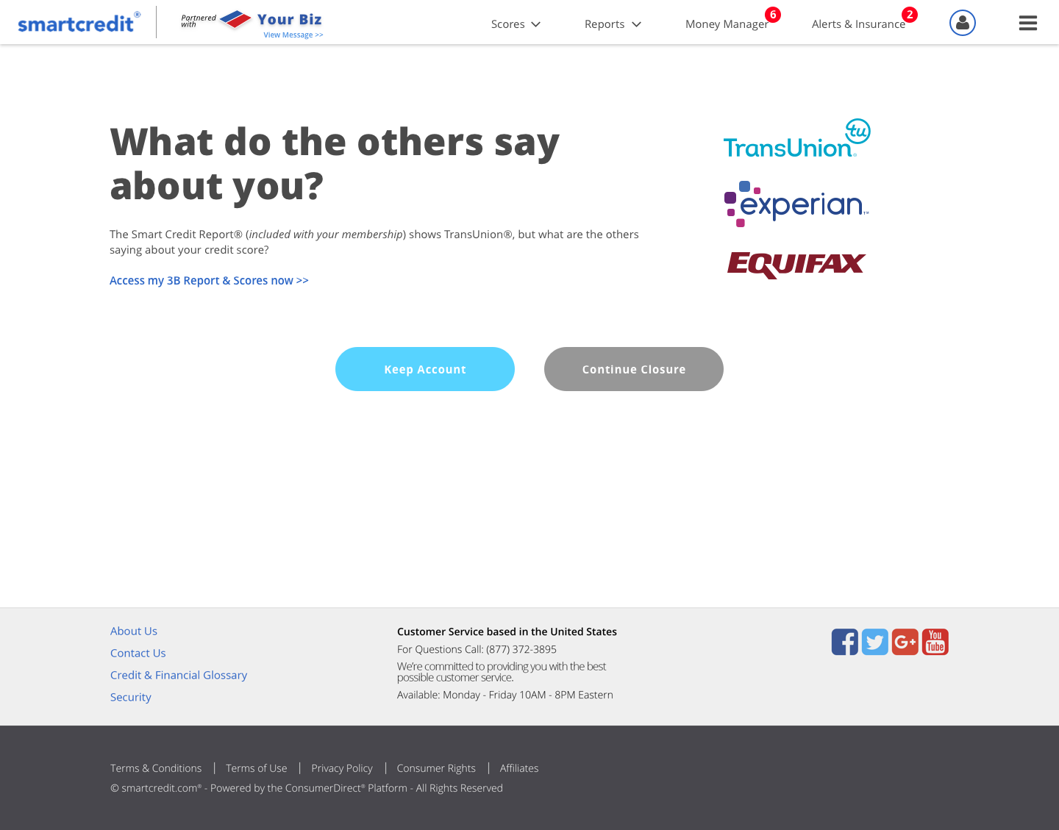
3-Bureau Report & Scores
Instantly compare your credit scores and
reports from each bureau in one secure place
Access our printable, PDF formated, easy-to-read, and side-by-side review that is ready for you at any time of the day
14
©2022 ConsumerDirect, Inc.® Proprietary and Confidential. All Rights Reserved.

Slide 15
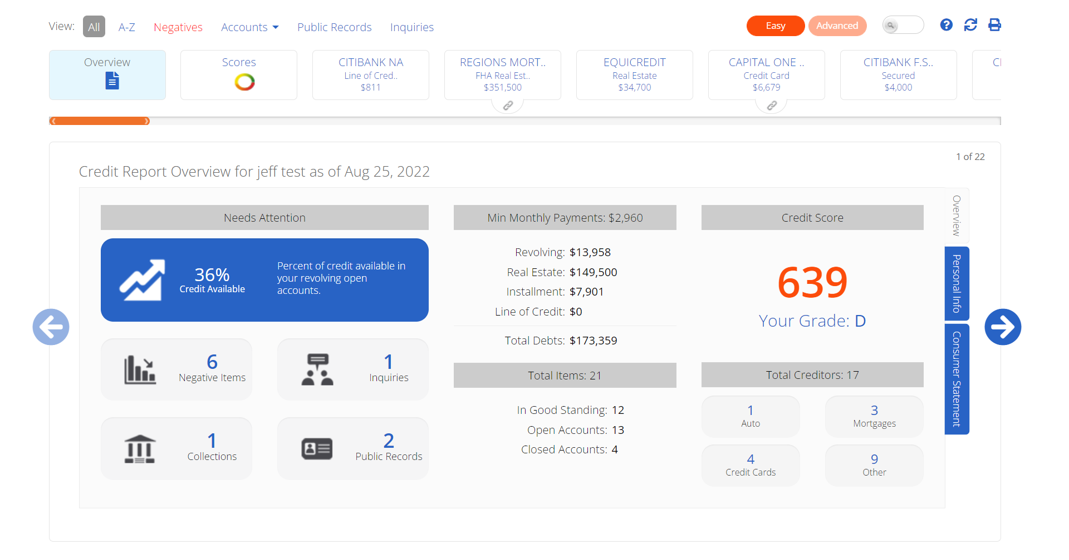
Smart Credit Report®
Unlimited Use on Some Plans
Credit reports impact your life in meaningful ways. With the Smart Credit Report®, understanding your credit is simpler than ever.
Easy advanced view
Move to different areas of your report with ease
Take Action directly from your accounts
Link to Money Manager to view transactions
15
©2022 ConsumerDirect, Inc.® Proprietary and Confidential. All Rights Reserved.

